Slide 1











people
14
16
20

Slide 2











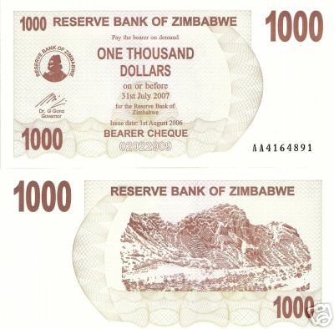





context

Slide 3







event
?
HIV
?

Slide 4

Objects
+
CD4
HIV
HIV
+
+
HIV
CD4
CD4

Slide 5




treatment
PrEP
PEP
ART
HIV+
HIV-
HIV?

Slide 6


















signs
HIV
HIV+ Privacy
Transgender
Spouse Privacy
Youth Privacy

Slide 7















symptoms

Slide 8


relation

Slide 9
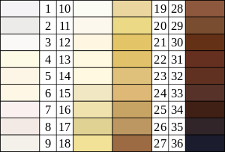
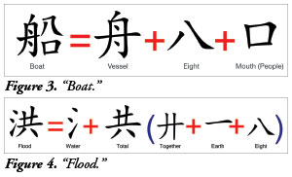
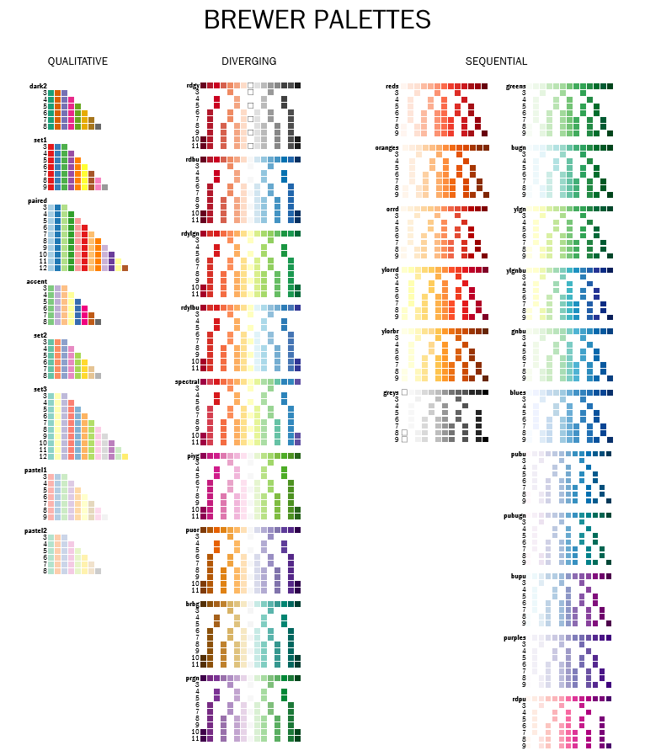
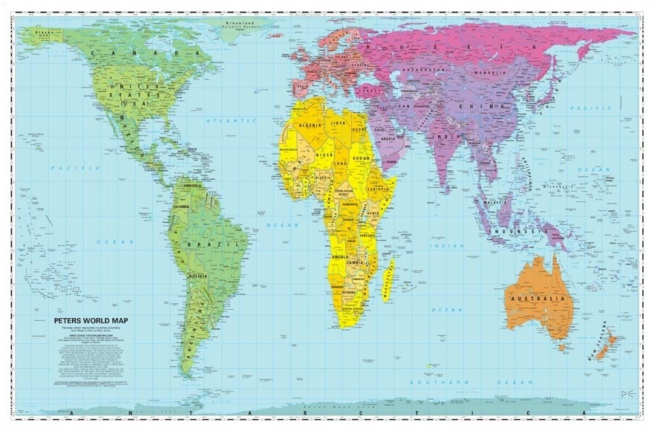
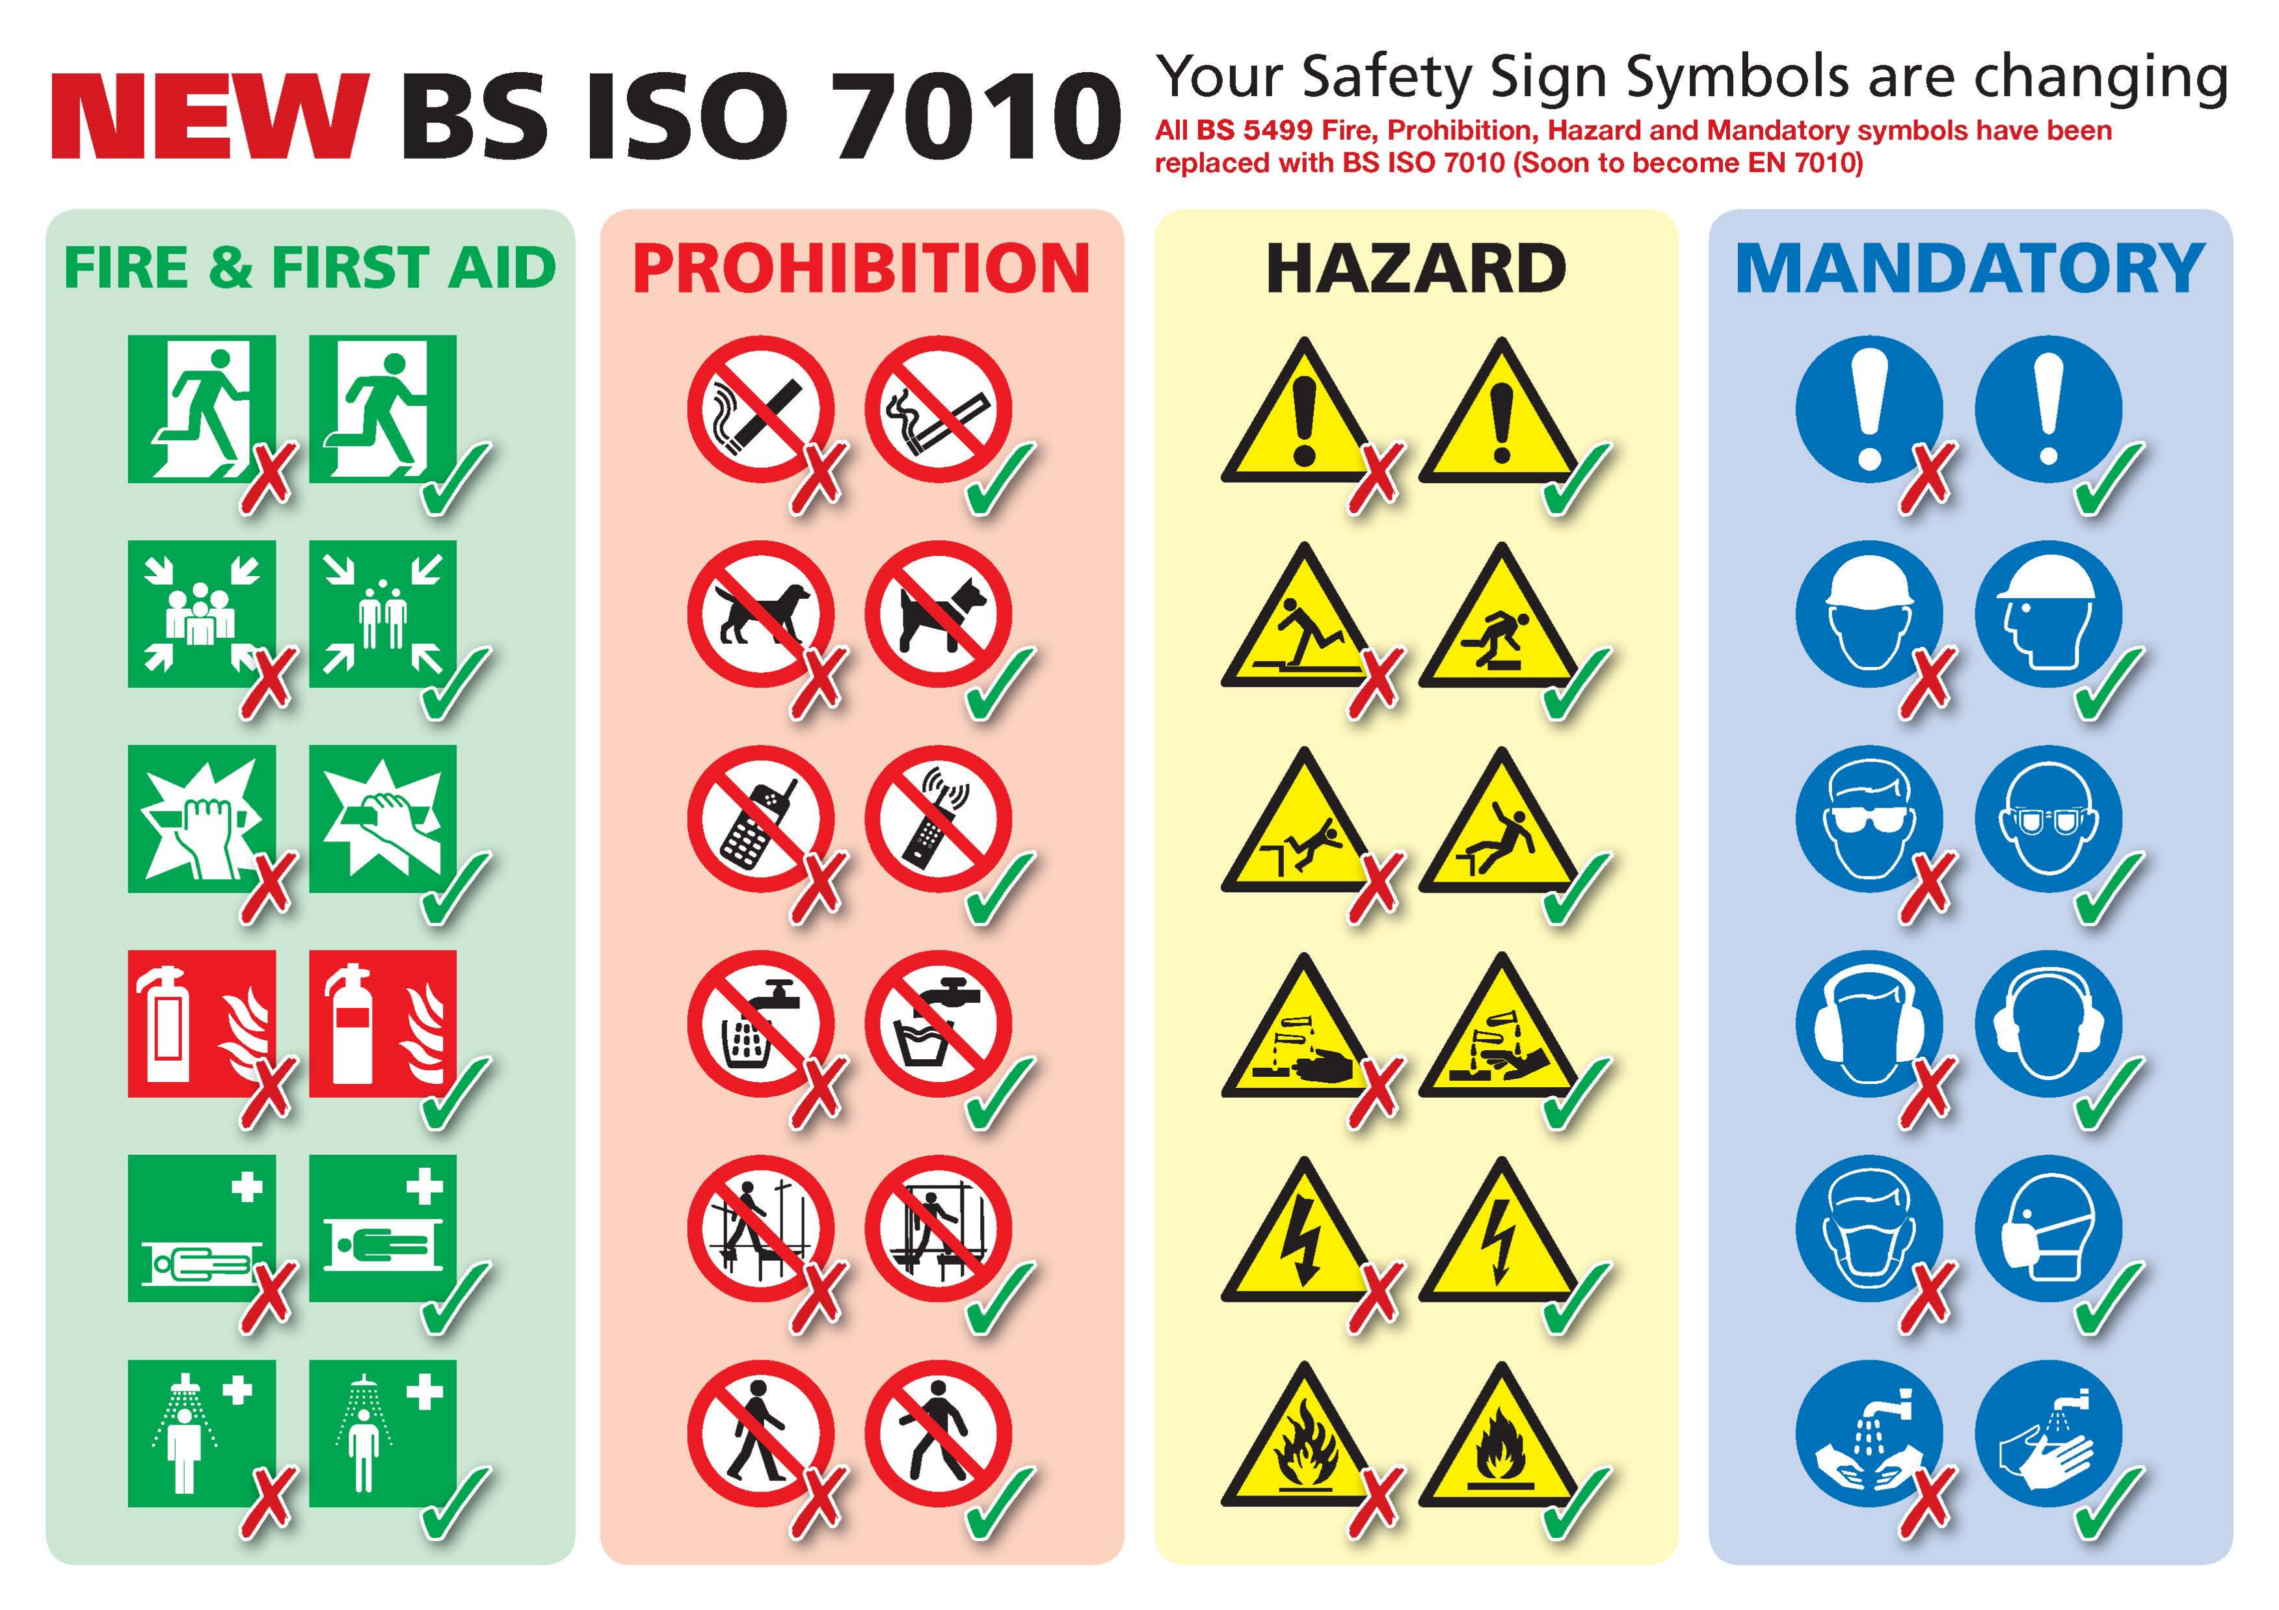
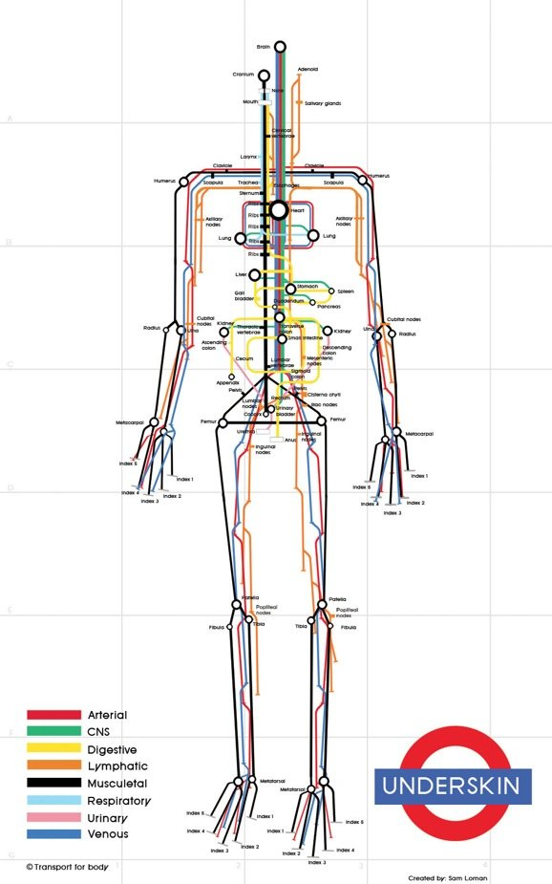
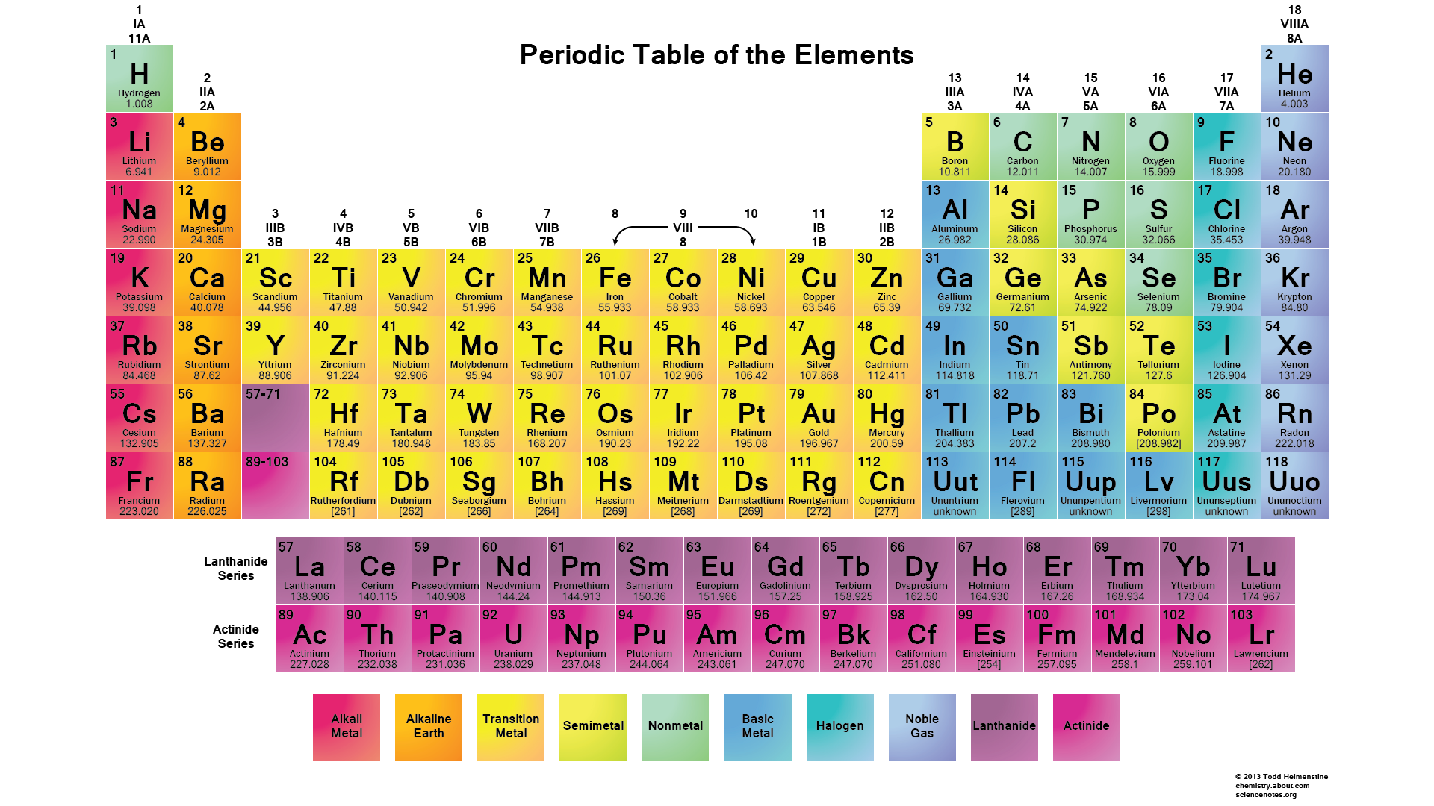
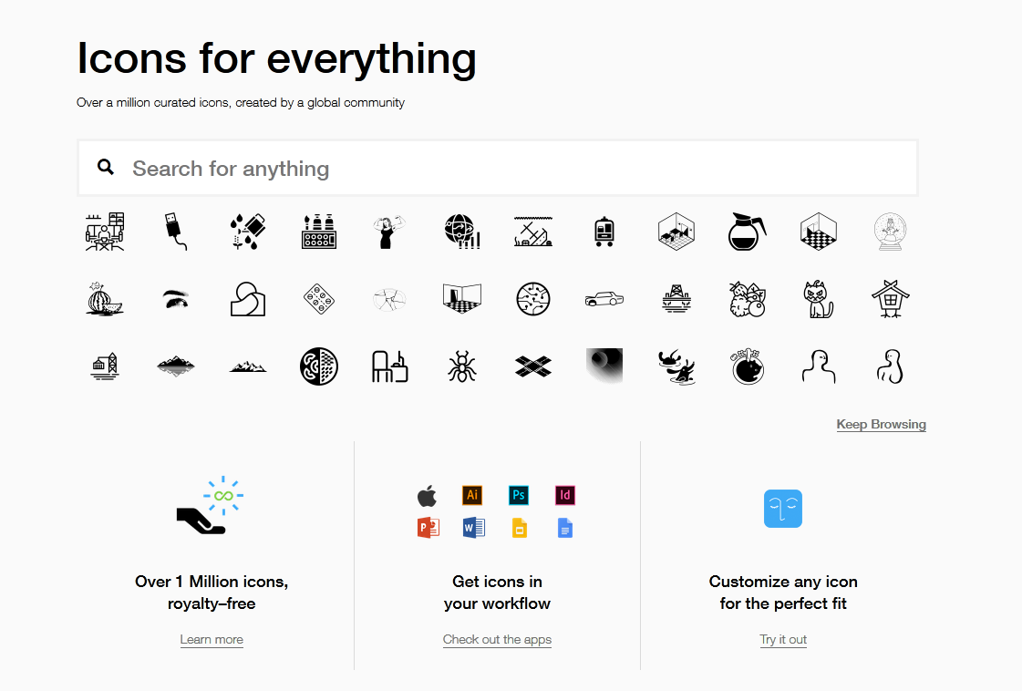
Design Inspiration
Noun Project, “icons for everything”
ISO Signs and Standards
Periodic Table
Traditional Chinese Pictography
Feng Shui
Von Lushan Skin Colors
Traditional Chinese Pictography
Combine simple icon to convey complex concepts
Peters Equal area world map
Brewer Palettes
Human Body Subway map

